Slide 1
Introduction to Scalability
Scalability In System Design

Slide 2

What is Scalability?
Scalability is the ability of a system to handle an increasing amount of work, or its potential to accommodate growth.
It ensures performance, reliability, and availability under growing load.

Slide 3
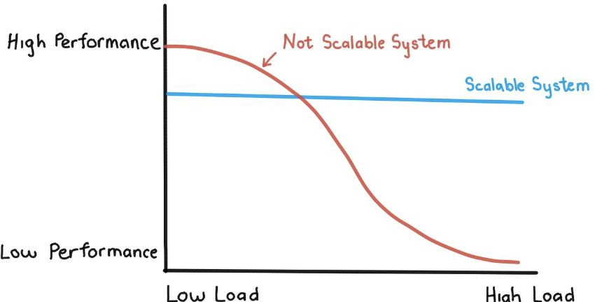
Why Do Systems Need to Scale?
User base growth (e.g., launching in new regions)
Increasing data volume (e.g., IoT, analytics)
Peak events (e.g., Black Friday, ticket sales)
Avoid service degradation or downtime
Meet performance SLAs

Slide 4
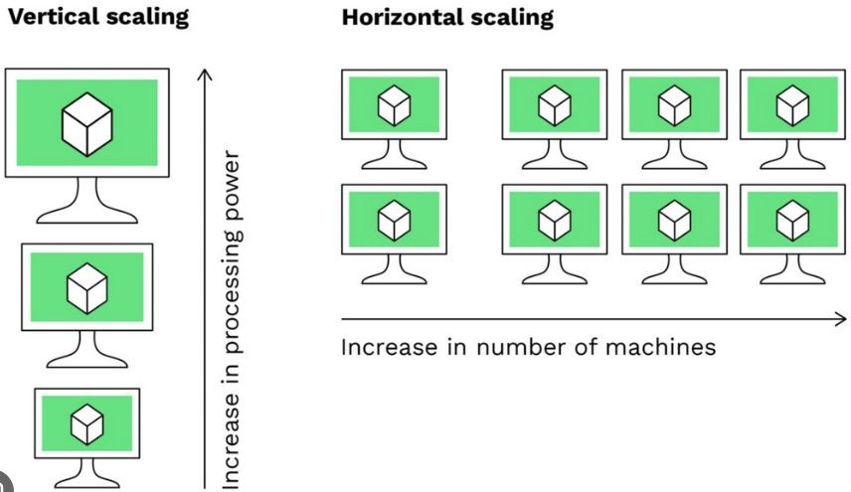

Types of Scalability (Intro)
Vertical Scaling: Add more CPU/RAM to one server
Horizontal Scaling: Add more servers to distribute the load
We'll go deep into these types in the next lecture

Slide 5
Common Challenges in Scaling
Latency
  Delay between request and response
  Causes: network hops, slow DB queries, synchronous calls
  Ampliﬁed in microservices/distributed systems
Bottlenecks
  One slow component = system-wide slowdown
  Examples: DB locks, memory limits, single-threaded processing
  Hard to predict as load grows
Downtime
  More nodes = more failure points
  Updates, redeployments, scaling events can cause outages
  High availability becomes harder
Cost
  Infrastructure isn’t free — CPU, RAM, bandwidth, etc.
  Autoscaling without limits = budget nightmare
  Over-provisioning = wasted spend

Slide 6
Interview Questions - Scaling
What does scalability mean in the context of system design?
Can you explain a real-world example where scalability was critical to success or failure?
What are the main challenges systems face as they scale?
How would you identify a bottleneck in a scalable architecture?
Why does latency increase with scale, and how can you mitigate it?
How do you balance scalability with cost in cloud-based systems?

Slide 7
Summary & What’s Next
Scalability helps systems grow without breaking
Two main types: vertical and horizontal
But it introduces latency, cost, and other risks
What’s Next:
  Scaling Strategies — how to actually implement horizontal, vertical, and diagonal scaling with trade-oﬀs and real-world choices

